Slide 1
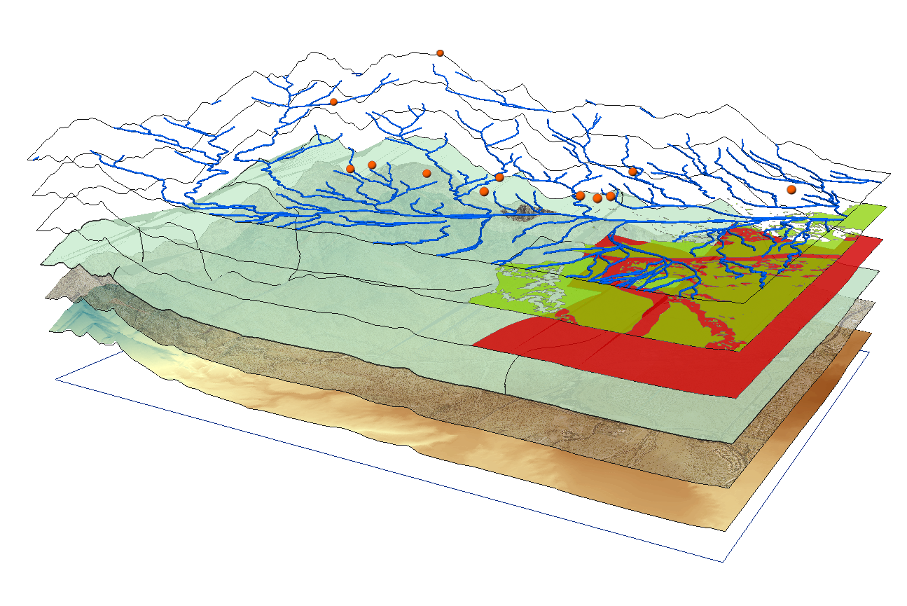
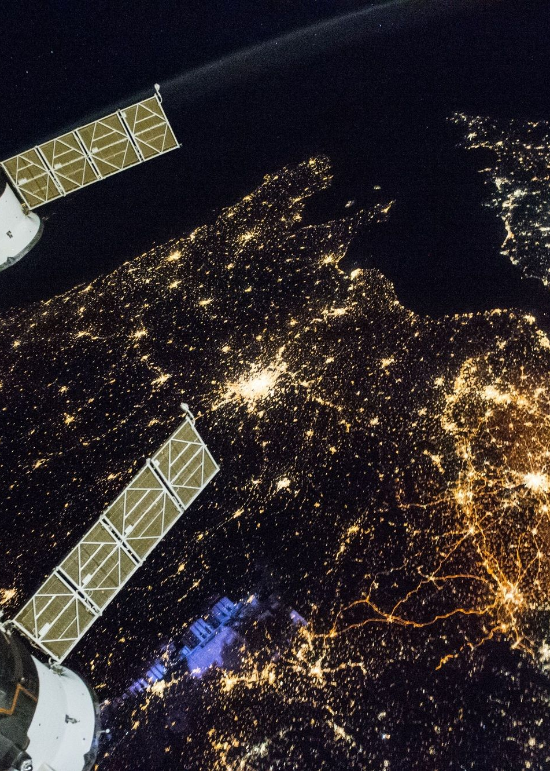
Object Detection and Recognition in Satellite Imagery: A case Study of Oyo State
In this presentation, we'll explore how deep learning tools can be used for object detection and recognition in satellite imagery, focusing on a case study in Oyo State, Nigeria.

Slide 2


LITERATURE REVIEW
The Importance of Satellite Imagery
The Rise of Deep Learning
The Challenges of Object Detection and Recognition
Satellite imagery is used in many fields, including cartography, agriculture, urban planning, and natural disaster management.
Deep learning tools, a subset of machine learning, significantly increase the accuracy of object detection and recognition in satellite imagery.
Satellite imagery is often complex, with varied weather and lighting conditions, and a wide range of object sizes and shapes.

Slide 3
LITERATURE REVIEW
Object Detection in Satellite Imagery: A Systematic Review" (T. Kussul, M. Lavreniuk, S. Skakun, 2017): This review provides a systematic overview of object detection techniques in satellite imagery. It covers traditional methods and emerging approaches, including machine learning and deep learning algorithms. The review discusses the challenges specific to satellite imagery, such as variations in resolution, lighting conditions, and image quality. It also highlights the applications and datasets used in object detection research, providing insights into the current state of the field

Slide 4

Several studies have validated the use of object detection and recognition techniques in satellite imagery for a range of applications. The techniques have proven effective in identifying crop types, land-use land-cover changes, and natural disasters in the past.

Slide 5
LITERATURE REVIEW
"Deep Learning for Object Detection in Remote Sensing Images: A Systematic Review and Meta-analysis" (H. Chen, Q. Jin, Q. Cao, et al., 2019): This review specifically explores the application of deep learning techniques for object detection in remote sensing images, including satellite imagery. It provides a systematic review of deep learning models, architectures, and datasets used in object detection tasks. The review analyzes the performance of different models and compares their strengths and limitations. It also discusses transfer learning, domain adaptation, and data augmentation techniques in the context of deep learning for object detection.

Slide 6
LITERATURE REVIEW
"Object Detection in Remote Sensing Images: A Survey and a New Benchmark" (X. Zhu, H. Xu, B. Li, 2018): This review focuses on object detection in remote sensing images, which include satellite imagery. It presents a comprehensive survey of existing algorithms and benchmarks for evaluating object detection performance. The review discusses the challenges related to scale variations, complex backgrounds, and class imbalance in remote sensing images. It also highlights recent advancements in deep learning-based object detection methods and their application in remote sensing.

Slide 7






AIMS AND OBJECTIVES
To Demonstrate
To Discuss
To Present
The power of Deep learning tools in ArcGIS Pro for object detection and recognition in Satellite Imagery.
The challenges associated with this technology.
A case study on object detection and recognition in Oyo State, Nigeria

Slide 8
LIMITATIONS OF THE PROJECT
One of the main limitations of this project is that it focuses on a specific region, Oyo State in Nigeria. The findings may not be transferable to other regions due to differences in environmental conditions, object types, and other factors. In addition, the project is limited by the quality and resolution of the available imagery, which may affect the accuracy of the results.

Slide 9

METHODOLOGY
IMAGE PRE-PROCESSING
We carried out atmospheric correction, radiometric correction, and image segmentation to create a uniform dataset.
1
2
3
DATA COLLECTION
OBJECT DETECTION AND RECOGNITION
We collected multispectral satellite imagery of Oyo State, Nigeria from 2015-2020 using Landsat 8 and Google Satelite Imagery of some area for Accuracy Assessment
We used the object-based image analysis technique and Google satellite imagery data to train our machine learning models for object detection and recognition.

Slide 10



Overview of Arc GIS Pro
What is Arc GIS Pro?
A leading geographic information system (GIS) software used for sophisticated mapping and spatial analytics.
What are the key features?
3D visualization, data management, analysis tools, and integrated workflows with other software.
What makes it stand out?
Easy-to-use interface, powerful functionality, and advanced customization options.

Slide 11
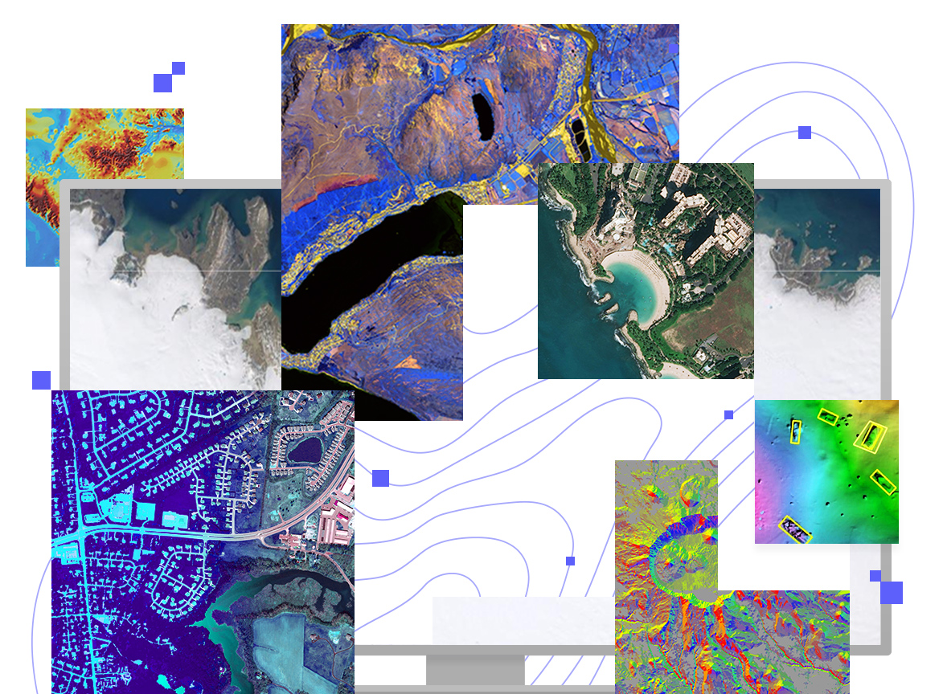
RESULT AND FINDINGS
The results that will obtained from the case study will demonstrate the effectiveness of object detection and recognition techniques for analyzing satellite imagery in ArcGIS Pro. The techniques provide accurate information for decision making in fields such as urban planning, emergency response, ecology, and resource management.

Slide 12


Conclusion and Future Directions
CONCLUSION
FUTURE RESEARCH
Object detection and recognition in satellite imagery are essential tools for solving real-world problems. ArcGIS Pro provides a capable platform for carrying out these techniques with high accuracy.
There is room for further research in the areas of object detection and recognition in high-resolution satellite imagery, 3D object reconstruction, and real-time processing of geospatial data

